Slide 1

Developing a Movie recommendation engine
with Spark

Slide 2
What are we going to learn today ?
At the end of the session, you will be able to know :
What is a recommendation engine
Major companies using recommendation engines
Different approaches to build recommendation engine
How to build a recommendation engine using Spark and Machine learning library (MLlib)

Slide 3
Transition – Search to Recommendation
We are leaving the era of search and entering one of discovery. What’s the difference? Search is what you do when you are looking for something. Discovery is when something wonderful that you didn’t know existed, finds you
CNN Money
The race to create a smart Google

Slide 4

Recommendations make life easier
Recommendations help user find information, products and services that user might not have thought of

Slide 5
Recommendation Approaches
Collaborative filtering
The user will be recommended items that people with similar tastes and preferences liked in the past
Content based
The user will be recommended items similar to the ones that user preferred in that past
Hybrid methods
Users are recommended by combining both collaborative filter and content based approaches

Slide 6

Lets take a small quiz

Slide 7
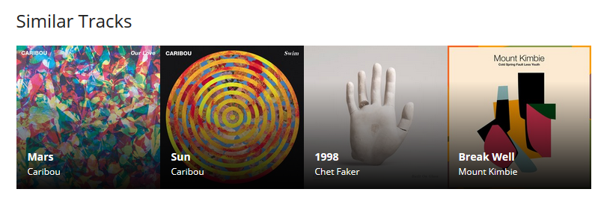
Recommendation Engine at LastFm
Which approach last.fm uses to recommend Music?
Recommended tracks by last.fm

Slide 8
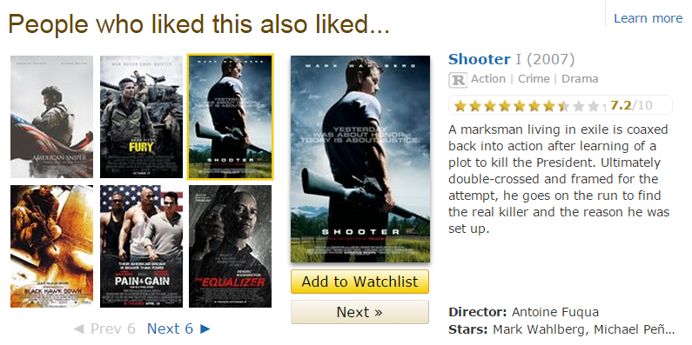
Recommendation Engine at IMDB
Movie recommendations by IMDB
Which approach IMDB uses to recommend movies ?

Slide 9
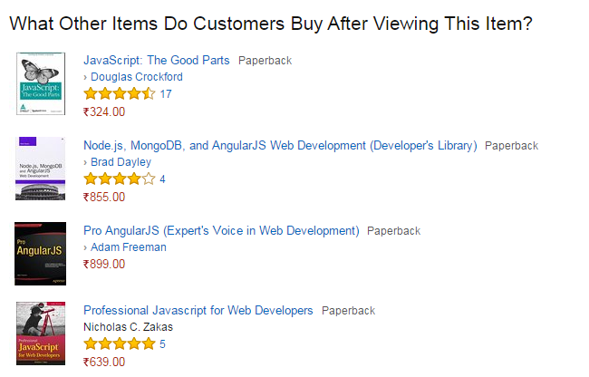
Recommendation Engine at Amazon
Recommended books by Amazon
Which approach Amazon uses to recommend items ?

Slide 10
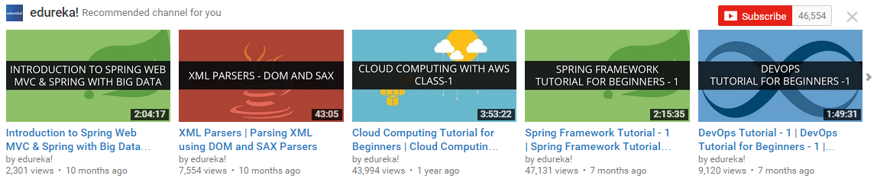
Recommendation Engine at Youtube
Which approach Youtube uses to recommend videos ?
Recommended Videos by Youtube

Slide 11
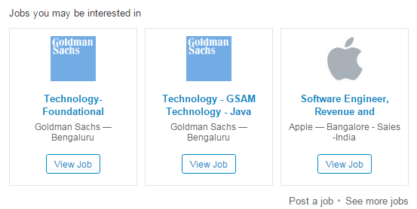
Recommendation Engine at LinkedIn
Which approach LinkedIn uses to recommend jobs?
Job recommendations by LinkedIn

Slide 12
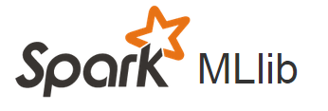

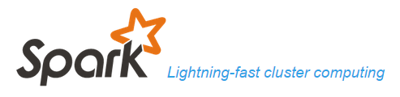
Implementing Recommendation Engine
To implement a recommendation engine we will require following :
Data source – to store historical data e.g. MySQL, MongoDB, HBase etc.
Spark - low latency computing
MLlib – library of machine learning algorithms

Slide 13

High Level Architecture - Recommendation Engine
MLlib
Data Source
Hadoop
Spark
Application
Recommendation Engine Architecture

Slide 14



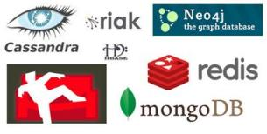



Step 1 - Data Source

Slide 15
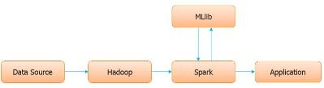
Step 2 – Hadoop to the rescue
One of the problem with different types of data sources is that raw data is not well structured and we need something which can store data from different data sources at a single place
Hadoop is the best fit which solves this problem

Slide 16

Step 3 - Spark
Once we have all the data in place we can use Spark to do in-memory computation on the data
Apache Spark is an in-memory cluster computing system which provides real time data processing capability.
Note that its possible to build a recommendation engine without using Spark. We can build a recommendation engine by only using Hadoop but since Hadoop reads and writes to disk not in-memory, which takes extra time. So a recommendation engine build using only Hadoop will not be a real time.

Slide 17
Step 4 - MLlib
Rather than writing the entire recommendation engine from scratch, we can use very popular MLlib library which provides machine learning algorithms to build a recommendation engine
SparkSQL
MLlib
Spark Streaming
Spark

Slide 18
High Level Architecture - Recommendation Engine
MLlib
Data Source
Hadoop
Spark
Application
Recommendation Engine Architecture

Slide 19
Lets See a Code Example
Code to build a recommendation engine

Slide 21
References
http://recommender-systems.org/content-based-filtering/
http://archive.fortune.com/magazines/fortune/fortune_archive/2006/11/27/8394347/index.htm
http://ampcamp.berkeley.edu/big-data-mini-course/movie-recommendation-with-mllib.html

